Slide 1

DEPARTMENT OF ARTIFICIAL INTELLIGENCE AND DATA SCIENCE
AUDISANKARA INSTITUTE OF TECHNOLOGY
(Autonomous)
Gudur,Tirupati-524101
A
Review
on
Rain Prediction: Machine Learning Classification for Predicting Rainfall
Batch No-9
Under the Guidance of
N.Subramanyam, M.Tech
Assistant Professor, Dept. of AI&DS
Presented By
S. Charan Kumar Reddy(202H1A3038)
K.Harshitha(202H1A3016)
P. Venkata Krishna Anand Reddy(202H1A3026)
P.Tejaswar Reddy(202H1A3031)

Slide 2
INTRODUCTION
Rainfall prediction is a crucial aspect of weather forecasting, with implications ranging from agriculture to disaster preparedness. traditional methods rely on historical data and meteorological models, which can sometimes be limited in accuracy or scalability. machine learning (ml) offers a promising alternative by leveraging the power of data to make accurate predictions.
Rainfall prediction is one of the most challenging tasks. though already many algorithms have being proposed but still accurate prediction of rainfall is very difficult. in an agricultural country like india, the success or failure of the crops and water scarcity in any year is always viewed with greatest concern. a small fluctuation in the seasonal rainfall can have devastating impacts on agriculture sector.
Accurate rainfall prediction has a potential benefit of preventing causalities and damages caused by natural disasters. under certain circumstances such as flood and drought, highly accurate rainfall prediction is useful for agriculture management and disaster prevention.

Slide 3
ABSTRACT
Rainfall prediction is a critical aspect of weather forecasting with numerous practical applications. traditional methods often rely on historical data and meteorological models, which may have limitations in accuracy and scalability. in this study, we explore the application of machine learning (ml) classification algorithms for predicting rainfall.
We utilize a dataset containing various weather-related features such as temperature, humidity, wind speed, and atmospheric pressure, collected over a period of time. the dataset also includes a binary target variable indicating whether it rained the following day.
Our approach involves a typical ml pipeline, including data preprocessing, feature selection, model selection, and evaluation. we experiment with several classification algorithms, including logistic regression, decision trees, random forests, and gradient boosting, to identify the most suitable model for the task.

Slide 4
PROBLEM STATEMENT
The goal of this study is to develop a machine learning (ml) classification model that can predict whether it will rain tomorrow in a given location. this binary classification task is challenging due to the complex & dynamic nature of weather patterns.
By leveraging a dataset containing various weather-related features such as temperature, humidity, wind speed, and atmospheric pressure, collected over time, we aim to train an ml model that can accurately predict rainfall.
The successful development of a rain prediction model could significantly improve the accuracy and reliability of weather forecasts, leading to more effective decision-making in various sectors reliant on weather information.

Slide 5
EXISTING SYSTEM
Agriculture is the strength of our indian economy. farmer only depends upon monsoon to be their cultivation. the good crop productivity needs good soil, fertilizer and also good climate. weather forecasting is the very important requirement of the each farmer.
Due to the sudden changes in climate/weather, the people are suffered economically and physically. weather prediction is one of the challenging problems in current state. the main motivation of this paper to predict the weather using various data mining techniques.
Such as classification, clustering, decision tree and also neural networks. weather related information is also called the meteorological data. in this paper the most commonly used weather parameters are rainfall, wind speed, temperature and cold.

Slide 6
DRAWBACKS
Data requirements: Machine learning models require large amounts of data for training, which may be challenging to obtain for some regions.
Interpretability: Some machine learning models, such as deep learning models, may lack interpretability, making it challenging to understand how they make predictions.
Overfitting: Without proper regularization and validation techniques, machine learning models may overfit to the training data, leading to poor generalization.

Slide 7
PROPOSED SYSTEM
Rainfall is important for food production plan, water resource management and all activity plans in the nature. the occurrence of prolonged dry period or heavy rain at the critical stages of the crop growth and development may lead to significant reduce crop yield. india is an agricultural country and its economy is largely based upon crop productivity. thus rainfall prediction becomes a significant factor in agricultural countries like india. rainfall forecasting has been one of the most scientifically and technologically challenging problems around the world in the last century.
Advantages
Improved accuracy: By leveraging machine learning algorithms, the proposed system can provide more accurate rainfall predictions compared to traditional methods.
Scalability: The system can scale to large datasets and provide real-time predictions, making it suitable for various applications.
Adaptability: The system can adapt to changing weather patterns and incorporate new data to improve prediction accuracy over time.

Slide 8
SYSTEM REQUIREMENTS
Hardware Requirements
Processor: Core I3/I5/I7
RAM : 4GB
HDD : 500 GB
Software Requirements
Platform : Windows Xp/7/8/10/11/12
Coding Language : Python
Complier: Jupiter

Slide 9
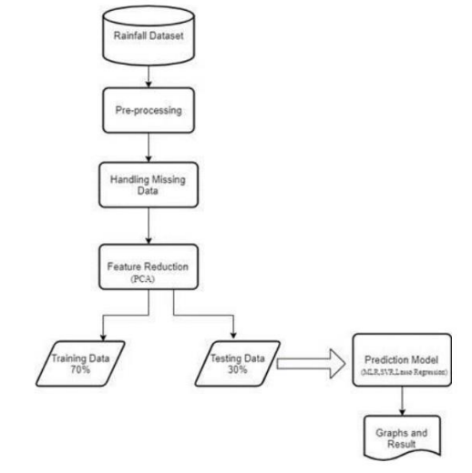
SYSTEM ARCHITECTURE

Slide 10
MODULES
Data Collection Module:
  Responsible for collecting weather data from various sources, including historical weather data and real-time weather updates.
Data Preprocessing Module:
  Handles preprocessing tasks such as handling missing values, outlier detection, normalization, and feature engineering.
Feature Selection Module:
  Selects the most relevant features for rainfall prediction using techniques like correlation analysis, feature importance, or domain knowledge.
Model Training Module:
  Trains machine learning classification models using the preprocessed data and selected features.

Slide 11
APPLICATIONS
Agriculture: Farmers rely on rain predictions to plan their planting, irrigation, and harvesting schedules. accurate forecasts help optimize water usage and prevent crop damage due to droughts or floods.
Water Resource Management: Water resource managers use rain predictions to anticipate water availability and plan reservoir releases, irrigation schedules, and drought mitigation measures.
Urban Planning: City planners use rain predictions to design stormwater management systems, mitigate flood risks, and plan infrastructure projects such as drainage systems and flood barriers.
Transportation: Rain forecasts are crucial for managing traffic flow, especially in urban areas prone to congestion and accidents during heavy rainfall. transportation authorities use this information to implement safety measures and reroute traffic if necessary.

Slide 12
PERFORMANCE METRICS
Accuracy: Accuracy measures the proportion of correctly predicted rainy and non-rainy instances. high accuracy indicates that the model is effectively distinguishing between rainy and non-rainy conditions.
F1 Score: The f1 score is the harmonic mean of precision and recall and provides a single metric that balances both.
Precision and Recall: Precision measures the proportion of correctly predicted rainy instances among all instances predicted as rainy, while recall measures the proportion of correctly predicted rainy instances among all actual rainy instances.
Mean Absolute Error (MAE) and Root Mean Squared Error (RMSE): These metrics quantify the average and root mean squared differences between predicted and observed rainfall amounts, respectively.
Lead Time: lead time measures the duration between the issuance of a rainfall forecast and the occurrence of rainfall events. longer lead times allow for better preparedness and decision-making in various applications.

Slide 13
EXPECTED RESULT
High Accuracy, Precision, Recall, and F1 score, indicating reliable differentiation between rainy and non-rainy conditions.
AUC close to 1, indicating excellent discrimination between rainy and non-rainy instances.
Low MAE and RMSE, indicating accurate prediction of rainfall amounts.
Minimal bias and positive skill score, indicating improvement over climatological or reference models.
Extended lead times, allowing stakeholders to make timely decisions and take appropriate actions in response to forecasted rainfall events.

Slide 14
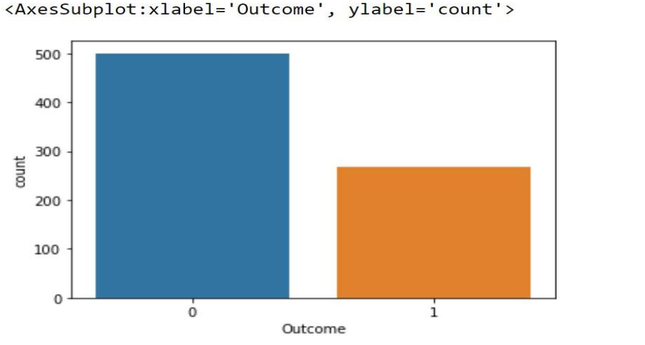
VISULIZATION

Slide 15
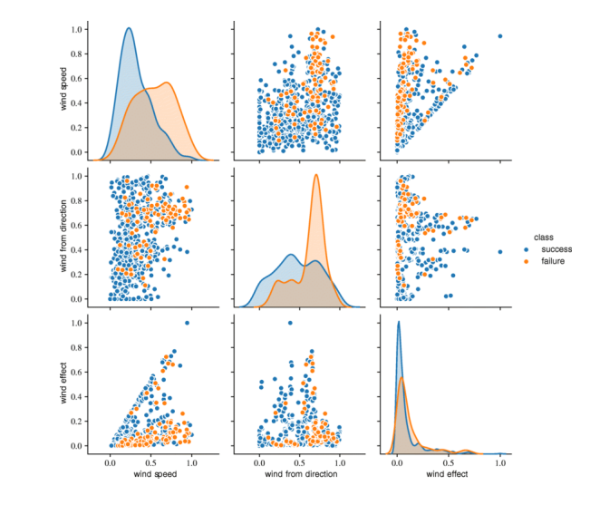

Slide 16
FUTURE ENHANCEMENT
Integration of Satellite Data: Incorporate satellite data, such as cloud cover and precipitation estimates, to improve the accuracy of rainfall predictions, especially in remote or data-scarce regions.
Temporal Data Analysis: Implement advanced temporal data analysis techniques to capture patterns and trends in weather data over time, leading to more accurate and reliable predictions.
Ensemble Learning Techniques: Explore ensemble learning techniques, such as stacking or blending, to combine multiple models and improve prediction performance.
Online Learning: Implement online learning algorithms to continuously update the model with new data, allowing for more adaptive and real-time predictions.

Slide 17
CONCLUSION
The application of machine learning classification algorithms for rainfall prediction represents a significant advancement in weather forecasting. by leveraging historical weather data and meteorological variables, machine learning models can provide accurate and timely predictions of rainfall, which is crucial for various sectors such as agriculture, water resource management, and disaster preparedness.
Throughout this project, we have explored the data collection, preprocessing, feature selection, model training, and evaluation processes involved in developing a rain prediction model. we have also discussed the limitations of traditional meteorological models and the potential benefits of using machine learning for rainfall prediction.

Slide 18


